Slide 1
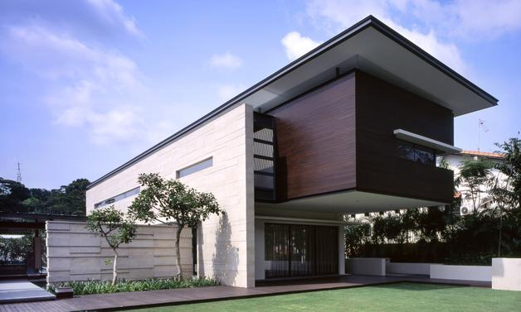
Andrew Road House By SCDA Architects (Chan Soo Khian)

Slide 2
Singapore practicing architect, founding principal and design director of SCDA, writer, visiting professor and developer
Born and raised in Penang, Malaysia but currently resides in Singapore
Louis Kahn, Otto Wagner, Le Corbusier, and Mies van der Rohe as design inspiration
Neo-tropical architecture = Asian + Western design, lots of courtyards
Phenomenology, sustainability and formal exploration
Unity between built form and nature
Local flora and fauna, available materials, and craftsmanship are important considerations
Chan Soo Khian
a.k.a Soo K. Chan

Slide 3
Architect’s Style
‘Neo Tropicality’
Modernism
Elegant geometric deal
Horizontality through dramatic oversailing eaves
Stone coursings
Prismatic Forms
Emphasis on Courtyards and Water Features
‘Chthonic’ concept
Inhabits the underworld & emerges from the earth
Devotes attention to the ground surface
Minimal & Sensuous
Usage of Raw/Natural Materials
Furniture, Light Fixture & Bathtubs
New Tropicality
Asian + Western

Slide 4
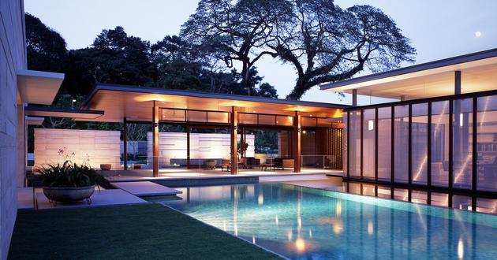
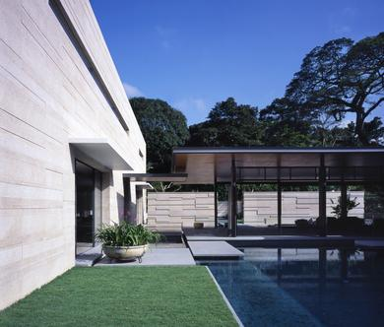
Design Concept Andrew Road House
Open & Closed form
Dynamics between positive & negative spaces
3 rectilinear prismatic volumes laid out in a U-shape around a swimming pool
An open sided reception pavilion
A timber clad block
A villa
Balance between internal and external spaces
Neutrality of the rectilinear forms used to define negative spaces
Balance the composition between the courtyards & the 3 blocks
Layering surfaces to create a deeper sense of perspective and space
Usage of “borrowed” space to visually enlarge the property
Ambiguity of surfaces applied in roof & ground platform
Language of floating planes meeting the sky (Granite Slab floats over the pool, water feature and lawn)
Horizontal axis (inside & outside walls) echoed on the vertical axis (Roof & floor planes)

Slide 5
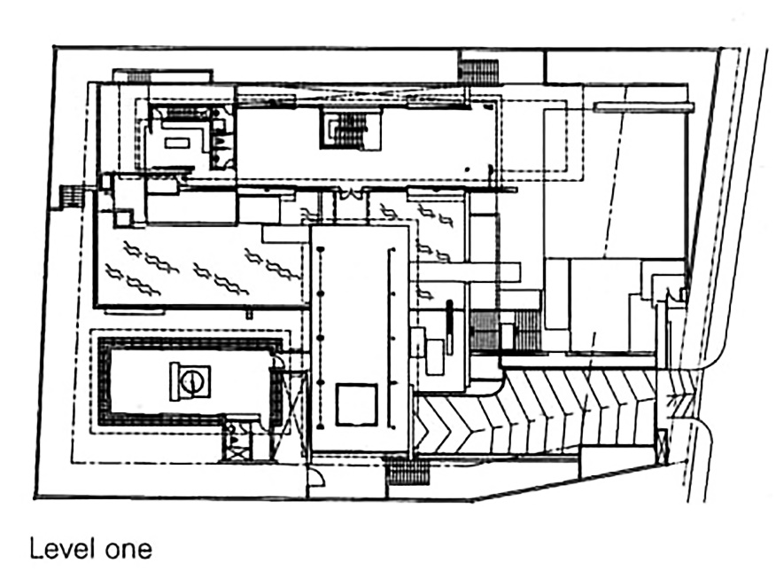
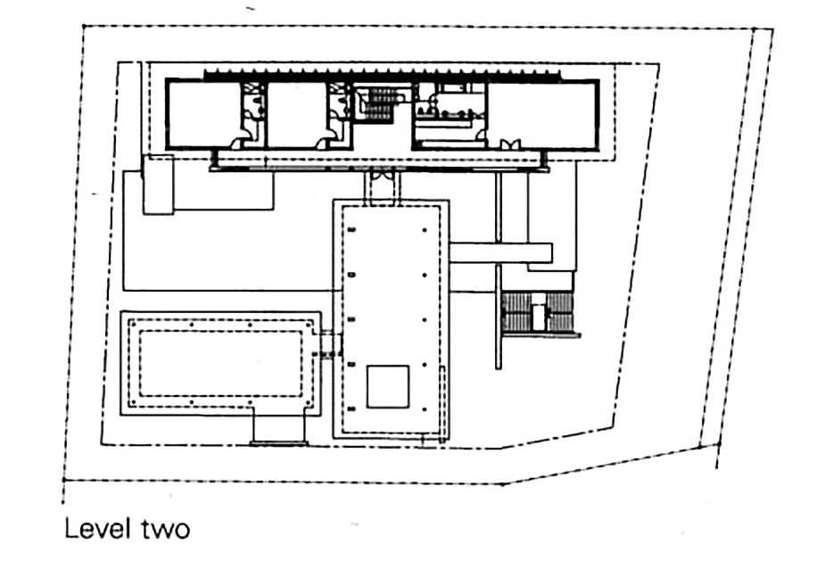
Design Layout Andrew Road House
Villa
6
5
8
4
7
2
3
Open Sided Reception Pavilion
9
Entertainment & Guest Suite
10
4
1
3 Volumes laid in a U shape
Ground Floor (Level One)
Driveway
Swimming Pool
Reflective Pool (Water Feature)
Living Room
Dining Room
Kitchen
Forecourt
Entry Foyer
Pavilion
Study Room
1st Floor (Level Two)
Master Bedroom
Bedroom
Upper Foyer
12
12
11
13

Slide 6
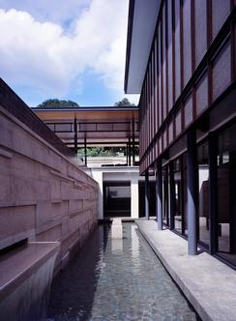
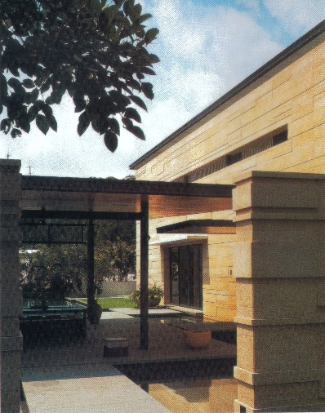
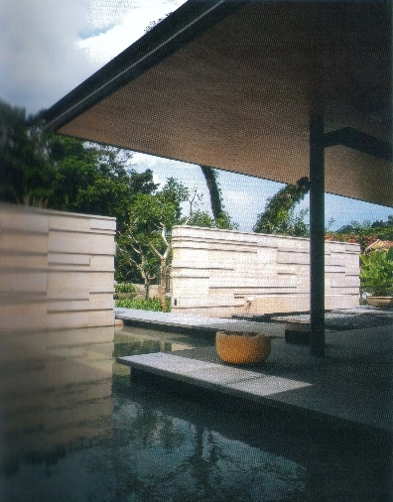
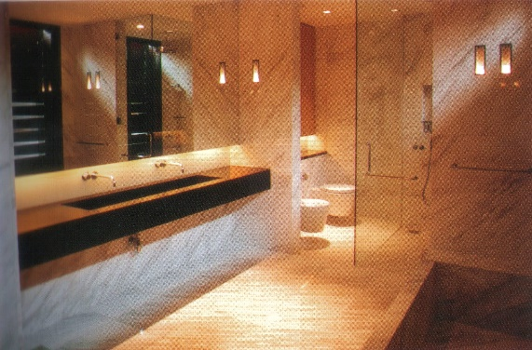
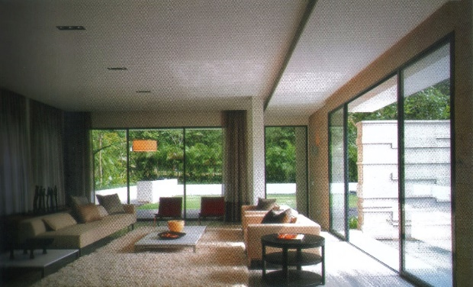
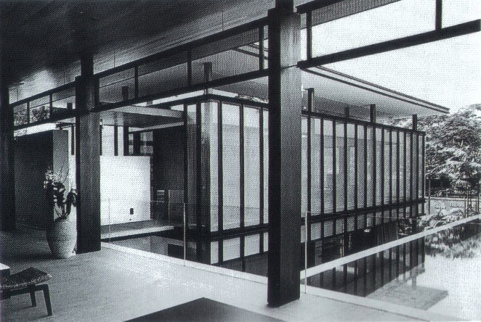
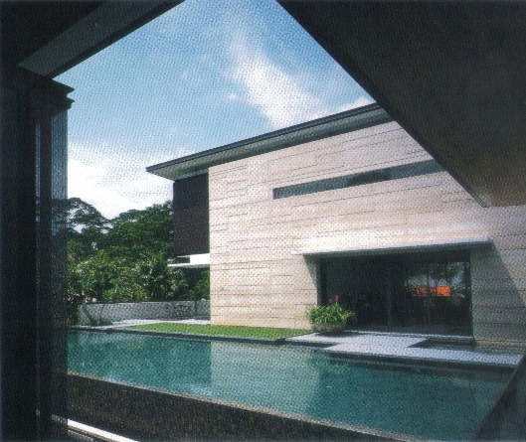
Materials Andrew Road House
Stone Walls veneered with rich striated pattern
Granite Slab & Timber Deck
Floats over the water features & grass
Act as a bridge between building blocks
Silver Travertine floor slab
Extended beyond the glass line
Overlaps with water feature to blur the boundary between inside & outside.
Planar Ceiling
Zinc-Titanium Roof
‘Floating’ rectangular sheets with thin steel edges
Clad underside with beech wood
Permeable metal screen on the 3rd block (Entertainment & guest suite)
Its semi transparency + shade + light at night creates a Diaphanous Lantern effect
1
2
4
3
5
6

Slide 7
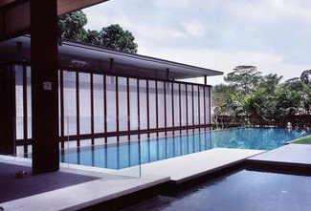
Significance Andrew Road House
①
Villa
Principal living, dining areas, and bedrooms
Northern boundary of the site
- Visually dominant in its composition
①
Villa
②
②
Entertainment Space
Pavilion
Pavilion
Serves as a reception area, gallery
Giant sliding screen walls open on all four sides
Revealed upon passing through an opening in a stone wall, across the pedestrian entrance axis
③
Bridge
Used in several location between blocks
Made of granite slabs
Add the element time in the choregraphed sequences of spaces
As simple floating platforms that overlap each other
③
Guest & Entertainment Suite
Overlooking swimming pool and waterfall
Lowest area of the site
Two storeys high, but the roof is same height as the pavilion
Clad with permeable metal screen
Anchored by 3 meter circular screen structure
Lined internally with a woven steel fabric

Slide 8
Overall Impact Andrew Road House
Strategy of choreographing a role in a series of staccato movement
The architecture unfolds a series of carefully orchestrated phenomenological experiences
Borrowed space allow the mind to expand to the horizon, a pleasure that is rarely enjoyed in compact urban setting’
Ambiguity created between positive and negative space plus interior and exterior zones, the body is brought closer to the environment
Results in a peaceful, tactile and personal experience of nature within a protected environment that blocks out all surrounding disturbance

